Slide 1
In-Class Activity
Class 04A
Solar Project w/ TI Kits

Slide 2
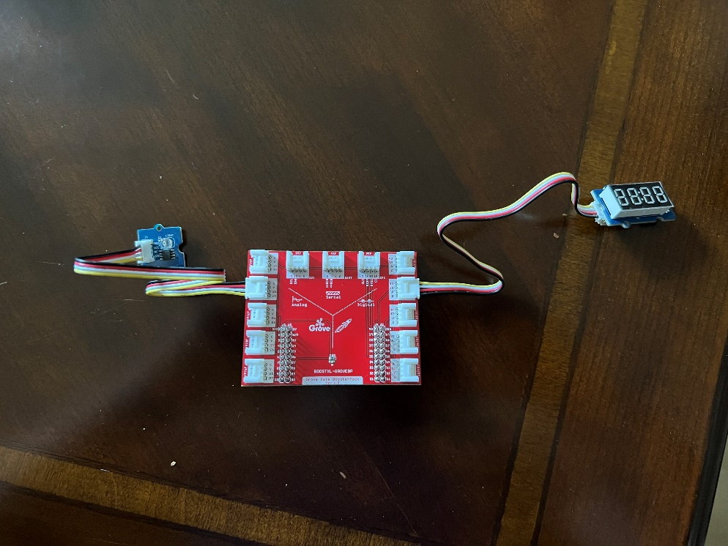
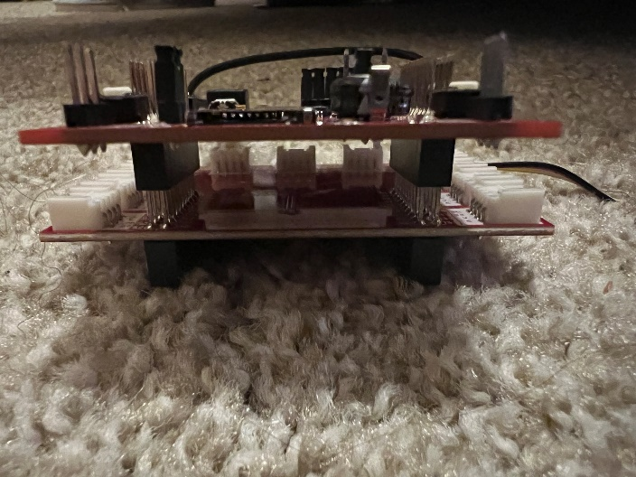
In-Class Activity: Solar Project w/ TI Kits
Goal: To provide hands-on experience collecting data relevant to solar energy utilizing the TI Kits.
Figure 2: Boosterpack with Light sensor and Four Digit Digital Display
Outcomes/Expected Results:
Display the light sensor output on a four-digit display
Record data from TI Kits to a csv file
Simulate the effect of various layers of cloud cover on solar energy
Figure 1: Side View of Boosterpack to TI Kit Connection

Slide 3
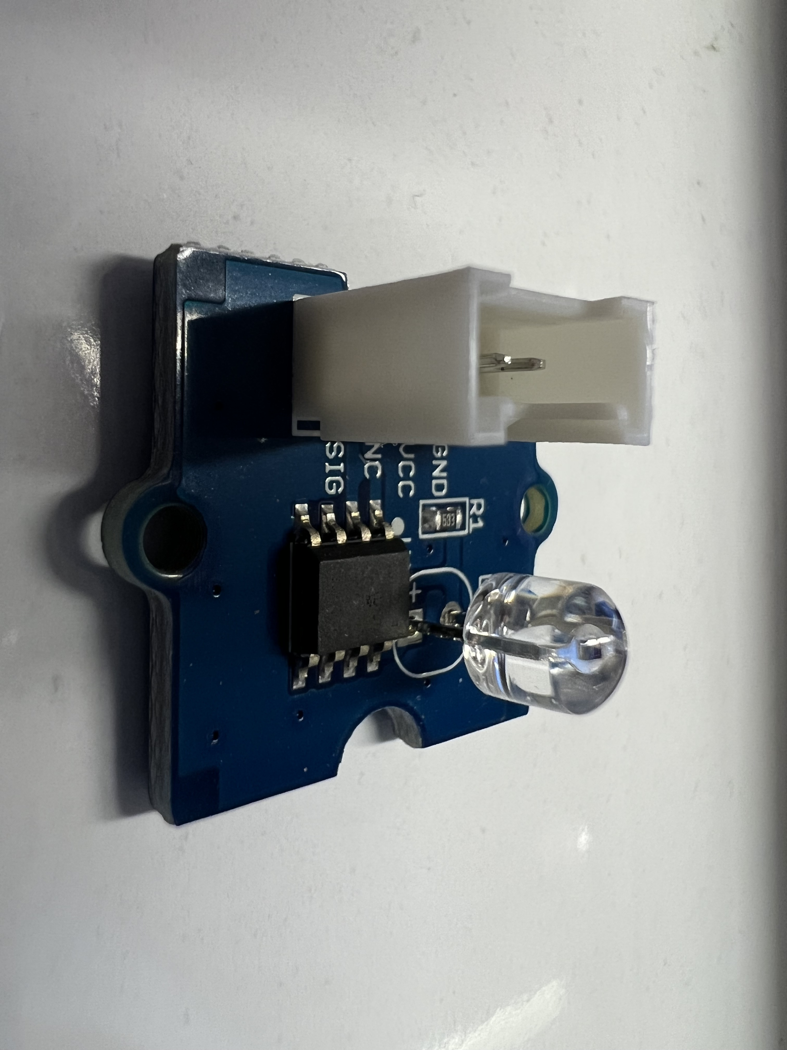
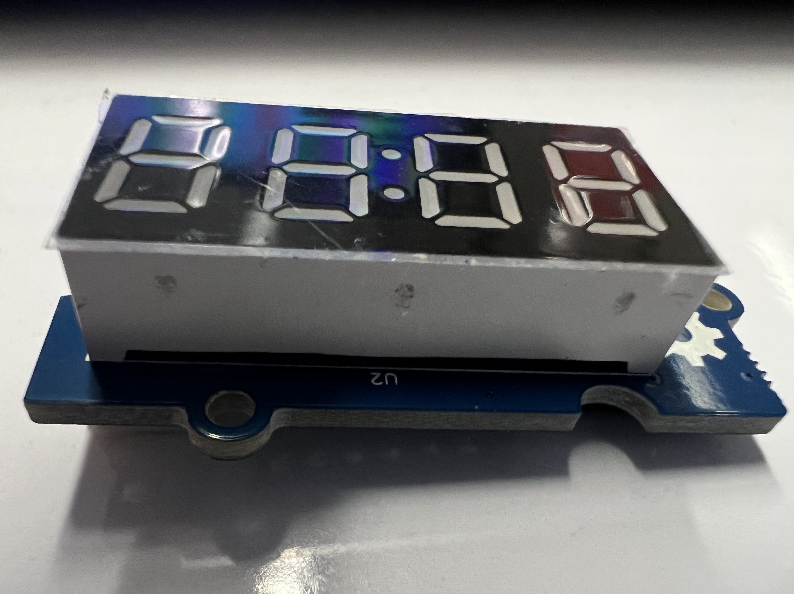
In-Class Activity: Solar Project w/ TI Kits
Equipment List:
TI Kit Microcontroller
TI Kit Booster Pack
USB A to Micro USB Powercable
2x Four Prong Connector Cable
Grove Starter Kit Light Sensor
Grove Starter Kit Four Digit Display
Figure 3 (Above): Grove Starter Kit Light Sensor
Figure 4 (Below): Grove Starter Kit Four Digit Display

Slide 4
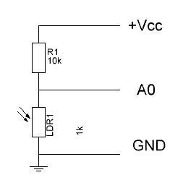
What are we actually measuring?
Light sensor is a light dependent resistor (LDR)
Resistance varies with the brightness
Measure voltage drop across LDR
Microcontroller measures voltage in bits depending on processing rate
V_{drop} = 5 / 4096 * reading
Lux = (500 * (5 - V_{drop})) / (10* V_{drop})
Figure 5 (Above): Grove Starter Kit Light Sensor
Figure 6 (Below): Light Sensor circuit Diagram

Slide 5
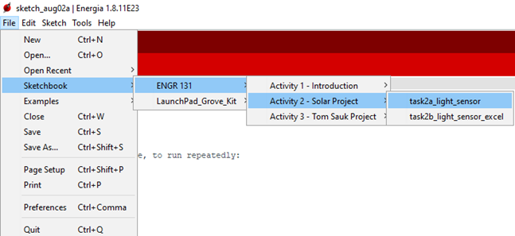
In-Class Activity: Solar Project w/ TI Kits
Task 2a: Configuring the Light Sensor and a Real-Time Readout on the Digital Display
Open the Sketchbook/ENGR 131/Activity 2 – Solar Project/Task2a_light_sensor file in Energia.
If you don’t see the ENGR 131 folder in your sketchbook options, please see the Getting Started page for download and instructions.
Before compiling and uploading the sketch, first you need to add to the board.
Connect the Grove Starter Kit Light Sensor to J6 of the Boosterpack using the four-prong connector cable
Connect the Grove Starter Kit Four Digit Digital Display to J14 of the Booster Pack using the four-prong connector cable.
Compile and upload the Light_sensor sketch to your TI Kit.
HINT: If this works, there should be a changing red number should be illuminated on your Grove Starter Kit Four Digit Digital Display
Create a block diagram of the TI Kit and sensors.
Take a picture of the TI Kit with an illuminated Four Digit Display
Figure 7: File Location of the Task2a_Light_sensor Sketch in Energia IDE’s sketchbook.

Slide 6
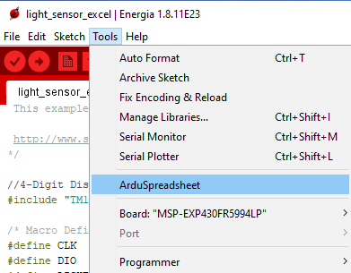
In-Class Activity: Solar Project w/ TI Kits
Task 2b:Communication between the TI Kit and Your Computer - Extracting Data from the Serial Port into Excel/CSV
Setting up the Grove Starter Kit Light Sensor to transmit data to the serial port.
Open the Sketchbook/ENGR131/Activity 2 – Solar Project/Task2b_light_sensor_excel
Compile and upload the Light_sensor_excel file to your TI Kit as assembled in Problem 1.
Open the Serial Monitor located in the Tools Menu to complete question 1.
Close the Serial Monitor
Utilize the ArduSpreadsheet to record data from the serial port to an excel sheet.
Open ArduSpreadsheet located in the Tools Menu to complete question 2.
Add a screenshot of the serial monitor window when 25 data points have been taken to your ICA answer sheet
Record 1-minute of data using the ArduSpreadsheet plug-in. Save this data and upload it with your ICA answer sheet
Figure 8: Energia IDE Tools Menu featuring the Arduspreadsheet plug-in

Slide 7
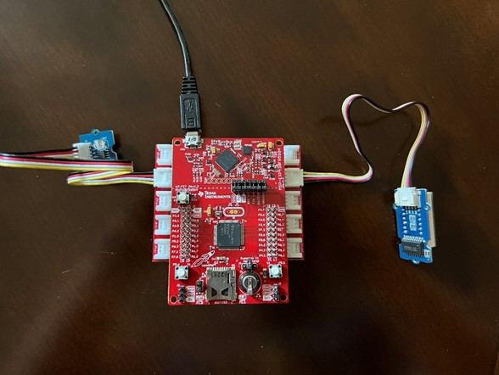
In-Class Activity: Solar Project w/ TI Kits
Task 2c: Real World Data Collection – Tissue Paper Filter
As in Problem 2, utilize the Grove Starter Kit Light Sensor and the ArduSpreadsheet plug-in.
Upload and compile the Light_sensor_excel file
Open the ArduSpreadsheet plug-in for use in question 1.
Record 1 minute of continuous data for each of the following cases:
Single Layer of Tissue Paper between light source and sensor
Fold the tissue paper in half (creating two layers) and place it between the light source and sensor
Fold the tissue paper in half again (creating four layers) and place it between the light source and sensor
Fold the tissue paper in half again (creating eight layers) and place it between the light source and sensor
Fold the tissue paper in half again (creating sixteen layers) and place it between the light source and sensor
Export the csv file and open it in Excel and perform the conversion discussed earlier from bits to Lux (units of light)
HINT: Your excel sheet should have three columns: Raw Data, Voltage Drop, Lux
Figure 9: TI Kit with attached Boosterpack connected to the Grove Starter Kit light sensor and four-digit digital display

